Slide 1
NATURE OF SCIENCE
·Each team must respond to each of the 3 Essential Questions.
·At least 2 members of each team must reply to at least 2 other team's responses. ( a total of 4 replies)

Slide 2
List 5
observations

Slide 3
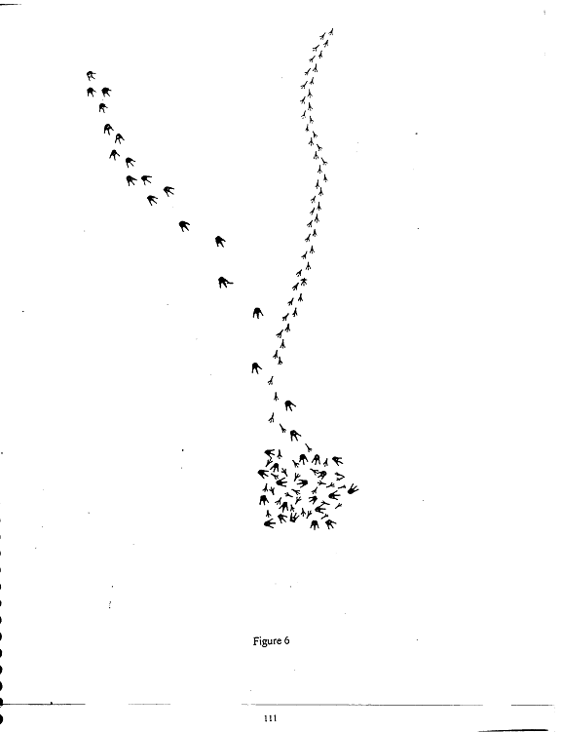
LIST AT LEAST
3 NEW
OBSERVATIONS

Slide 4
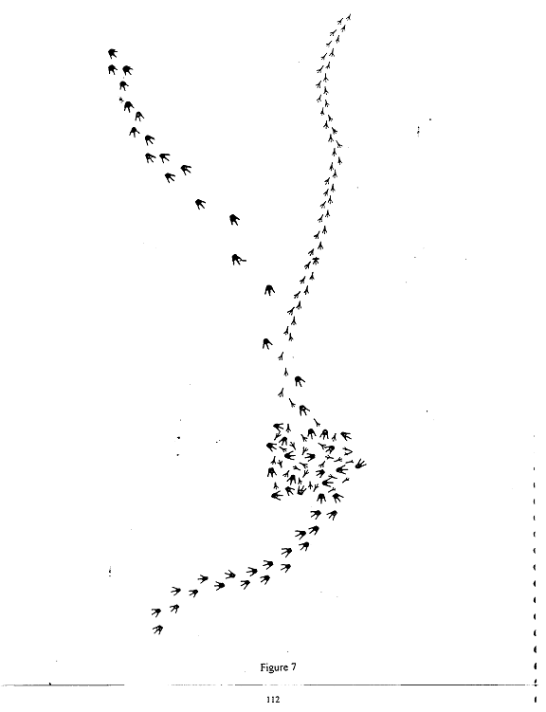
MAKE 2 MORE
OBSERVATIONS

Slide 5
Did you use the Scientific Method to help you make your Observations?
·What are the steps of the scientific method?
·List all of them.
·Do you think other people have a different list?
·What about the following slides?

Slide 6
METHOD
·Identify the problem
·Make observations
·Create hypotheses
·Make predictions
·Test hypotheses
·Reject, support, or modify the hypotheses

Slide 7
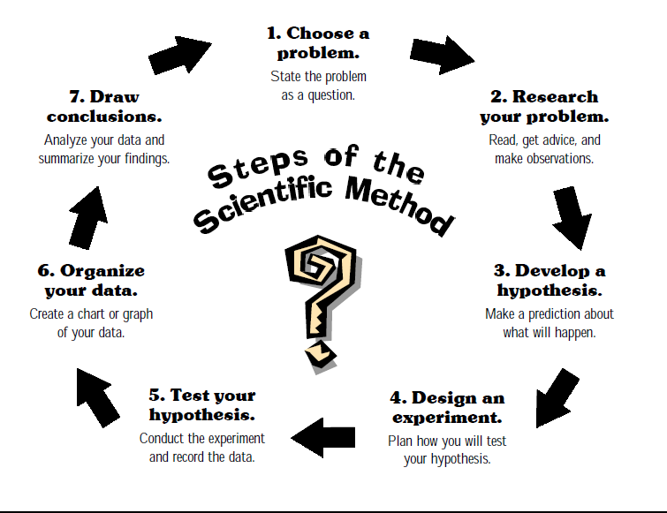

Slide 8
Ways of Knowing
·Science--testable and empirical
·Religion--higher authority
·Philosophy--logical

Slide 9
Multiple Ways of Knowing
·In science, as a community of people we have decided upon what is acceptable based upon empirical and testable data.

Slide 10
Scientific Knowledge is…
·Tentative (subject to change)
·Empirically based (based on and/or derived from observations of the natural world)
·Subjective
·Necessarily involves human inference, imagination, and creativity
·Socially and culturally embedded
·Reproducible

Slide 11
Science has 3 Aspects
·A Body of Knowledge
·A Process or Method
A way of constructing knowledge about the natural world (i.e., NOS) that distinguishes it from other disciplines or ways of knowing.
*Scientific knowledge is not provable in an absolute sense, objective, and devoid of creativity and human imagination.

Slide 12
How are facts, laws, theories, and hypotheses related?
·Can you define each one?
·Make sure you don’t confuse these.
·Is there a linear relationship? If so or not, why?
·Remember there is not one scientific method.

Slide 13
Misconceived Notion of the Relationship of the
Categories of Scientific Knowledge
Law
Theory
Hypothesis
Observations

Slide 14
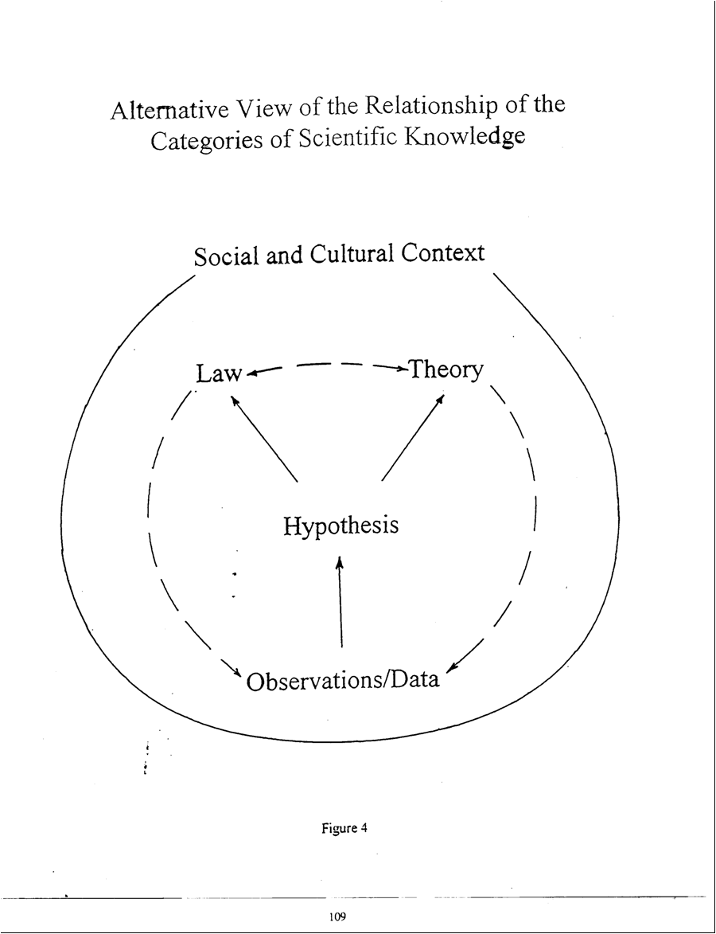

Slide 15
·Laws are far-reaching statements of universal relationships related to some aspect of the natural world.
It is usually in the form of a mathematical equation.
Theories are justifiable explanations of facts, laws, and tested hypotheses.
Theories DO NOT become laws even with additional evidence; they explain laws, but not all laws have corresponding theories.

Slide 16
·A Hypothesis can either serve as a description of the relationship between a set of observable phenomena or as an inferred explanation for those phenomena.
·As such, a hypothesis, or set of hypotheses, can develop into a theory or a law.
· Hypotheses explain relatively limited sets of observations in a certain field of scientific research.

