Slide 1
CHAPTER 13
Genetic Engineering

Slide 2
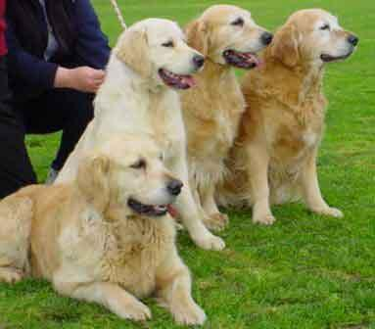
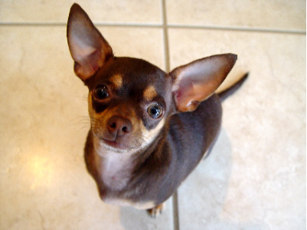
13-1 Changing the Living World
Selective Breeding
Choosing the “best” traits for breeding
Most domestic animals are products of SB

Slide 3
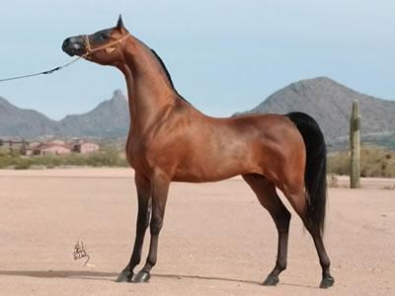
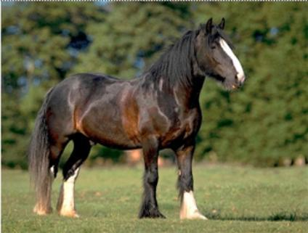
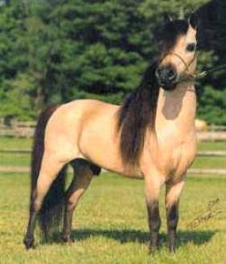
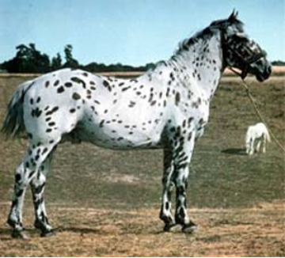
HORSES

Slide 4
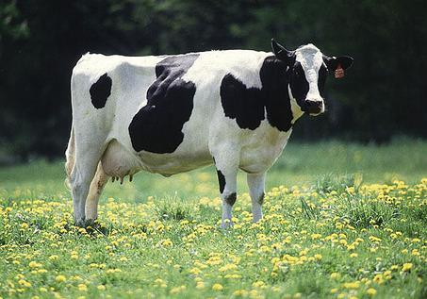
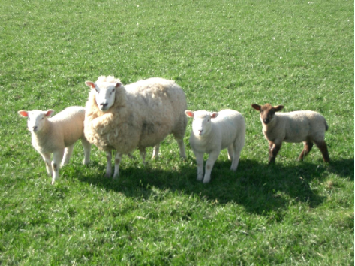
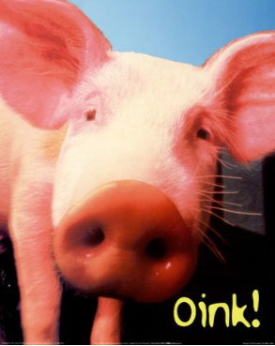
Even Cows, Sheep, & Pigs
All Products of Selective Breeding (Artificial Selection)

Slide 5
Hybridization
Crossing dissimilar individuals to bring together the best traits of both organisms
Produces hybrids
* Hybrids can be different species crossed together or different types within the same species.

Slide 6
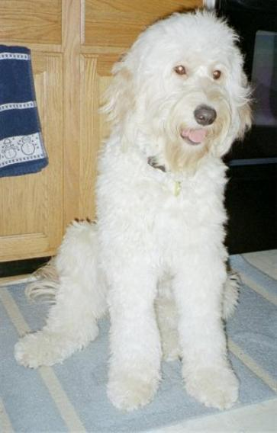
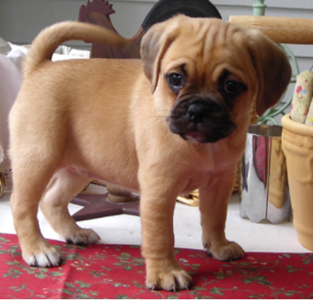
Golden Doodle Puggle
Designer breeds or mutts?

Slide 7
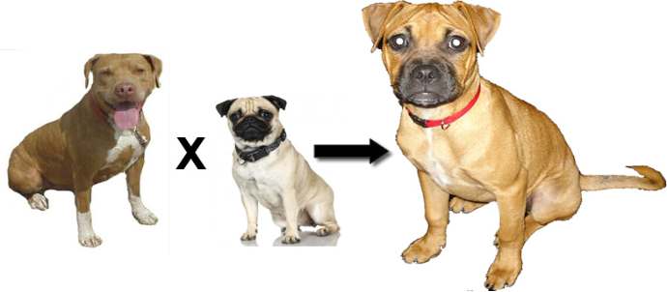
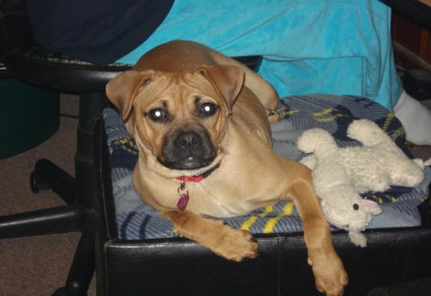

Slide 8
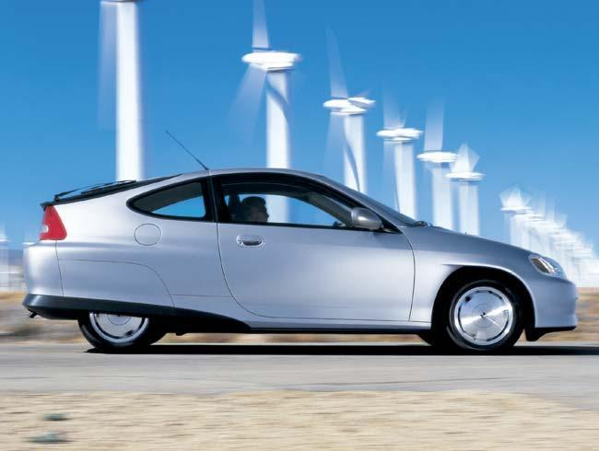
Not to be confused with hybrid cars..

Slide 9
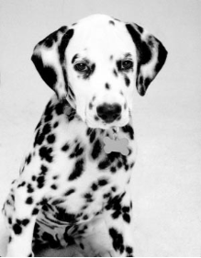
INBREEDING
Inbreeding = continued breeding of similar individuals
(ex. pure breed dogs)
Has risks… increases breed’s susceptibility to disease & deformities
Golden retrievers - epilepsy
Dalmations - hereditary deafness

Slide 10
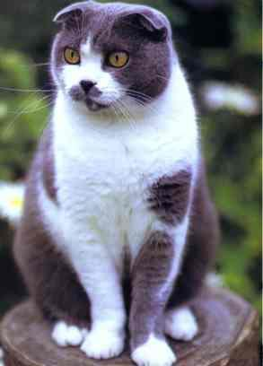
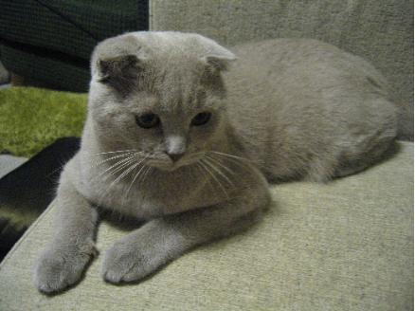
Increasing Variation
Breeders can increase variation in a population by inducing mutations
Mutation = any change in DNA
Mutations can happen randomly, as in this Scottish fold cat. Cat enthusiasts bred these cats from a single cat with a mutation for the ears.

Slide 11
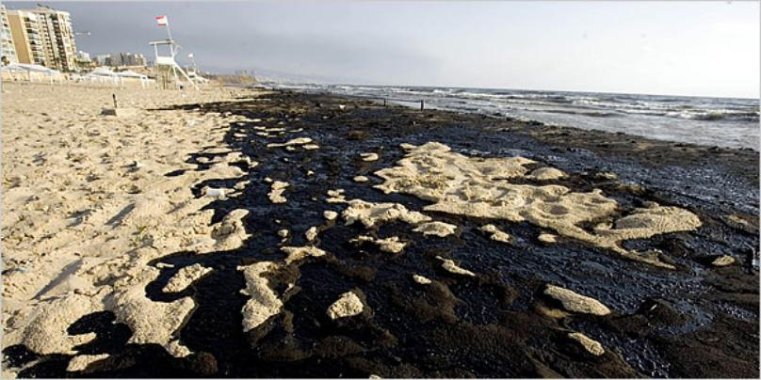
Mutations produce new kinds of bacteria
ex. oil-eating bacteria

Slide 12
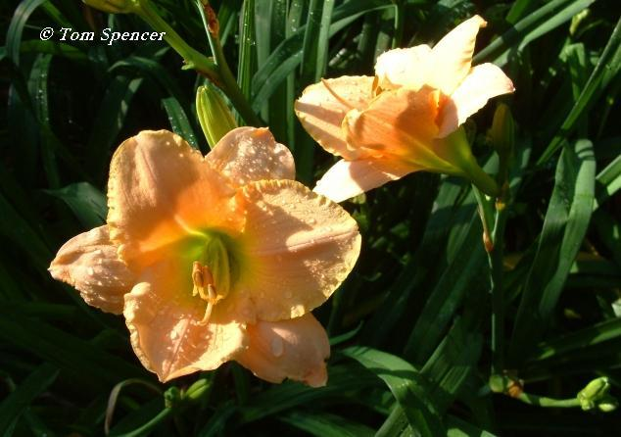
Mutations produce new kinds of plants
Ex. day lilies, bananas, citrus fruits
Polyploid plants have multiple sets of chromosomes.

Slide 13
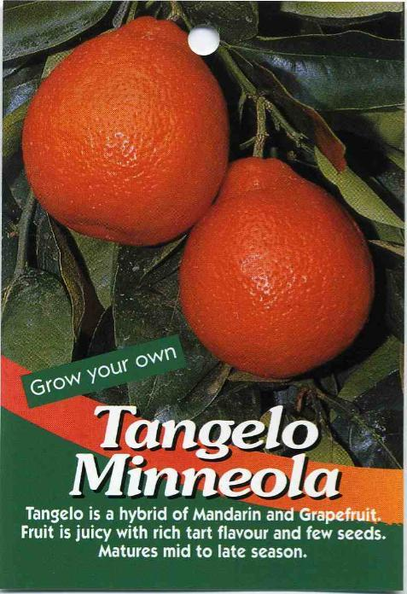

Slide 14
1. Dogs and other domestic animals were produced through many years of _______ breeding.
2. Two dissimilar organisms crossed together is called ___________________
3. Purebred dogs can sometimes have poor health due to __________
4. Any change in DNA is a ________
5. Designer dogs, such as the puggle are also called _______________

Slide 15
13-2 Manipulating DNA
How are changes made to DNA?
Scientists use their knowledge of the structure of DNA & its chemical properties to study & change DNA molecules
*This is GENETIC ENGINEERING

Slide 16
Different techniques are used…
to extract DNA from cells
to cut DNA into smaller pieces
to identify the sequence of bases in a DNA molecule
to make unlimited copies of DNA

Slide 17
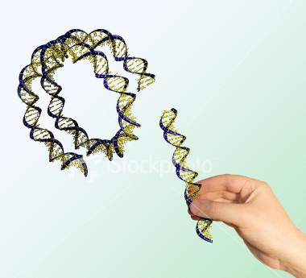
Genetic engineering
= making changes in the DNA code of a living organism

Slide 18
a.) DNA extraction – simple chemical process to get DNA out of cell; cells are opened & DNA is separated from other cell parts
b.) cutting DNA – restriction enzymes are used to cut DNA at specific sequences of nucleotides

Slide 19
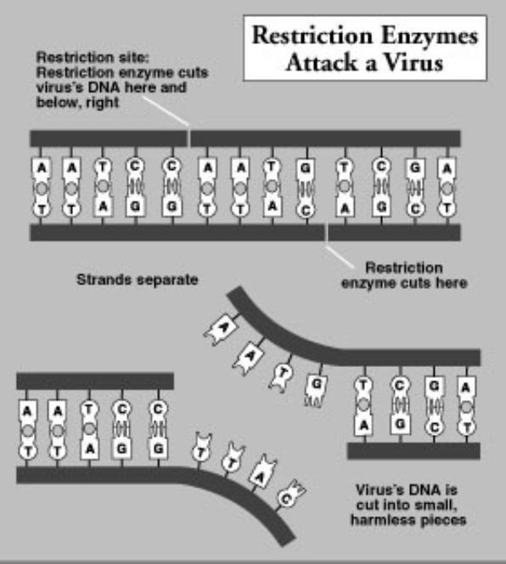

Slide 20
c.) separating & analyzing DNA
Scientist use gel electrophoresis =
-DNA fragments are put at one end of a gel
electric current is applied to gel
DNA molecules move

Slide 21
DNA SEQUENCE
- can be used to solve crimes or determine paternity
- requires restriction enzyme to cut the DNA , and electrophoresis to separate it

Slide 22
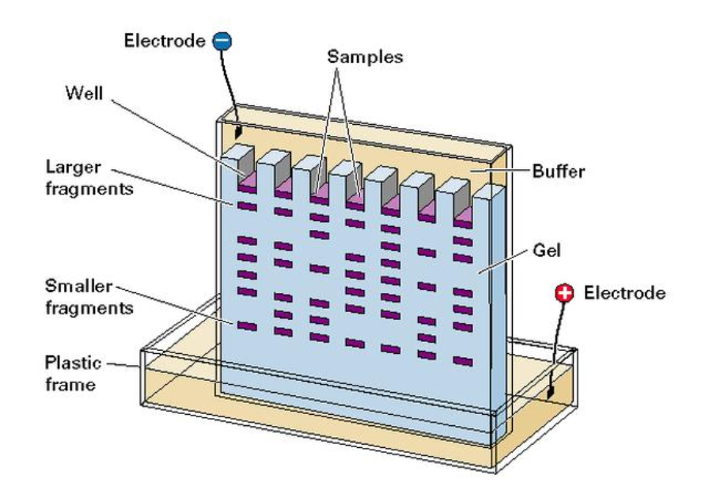

Slide 23
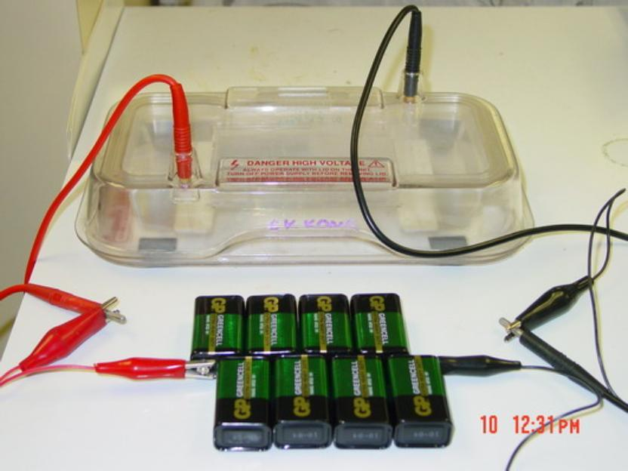

Slide 24
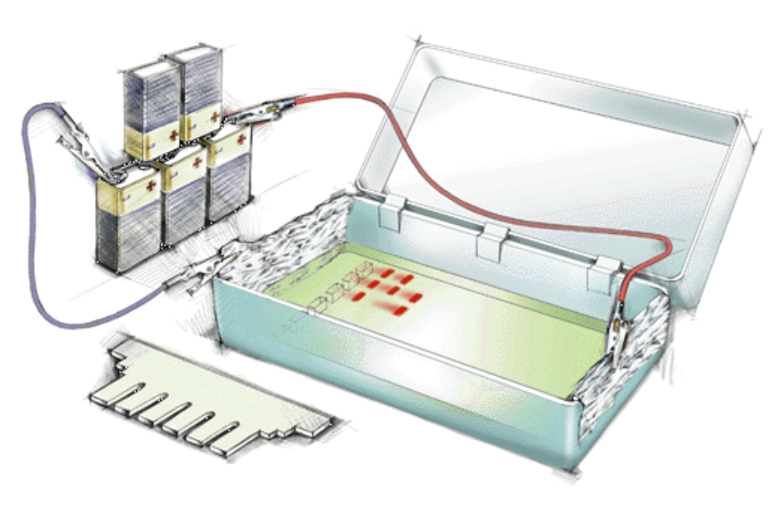

Slide 25
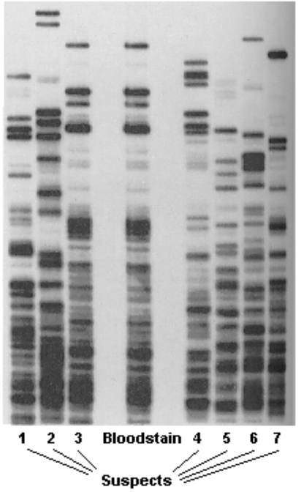
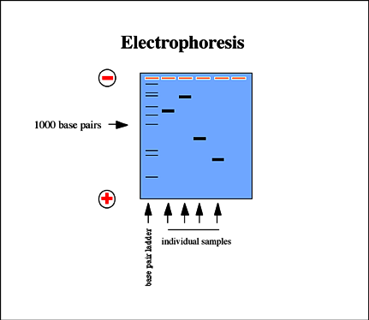

Slide 26
d.) recombinant DNA – DNA produced by combining DNA from different sources
e.) making copies
Polymerase chain reaction (PCR)
used to make multiple copies of genes

Slide 27
1. Making changes to DNA is called _________________ _______________
2. A ________________ enzyme is used to cut DNA into pieces.
3. Gel __________________________ is used to separate DNA fragments
4. The polymerase chain reaction (PCR) is used to make ______________ of DNA
5. Scientists can _________ DNA from any cell or body tissue.
6. When DNA from two different organisms is combined, it is called _______________ DNA
7. A DNA _____________ can be read to determine paternity or solve crimes

Slide 28
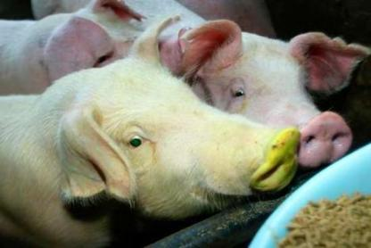
Transgenic Organisms
Contains genes from other species
Microorganisms (bacteria)
Animals (mouse; medical uses)
Plants (agricultural uses)
*GM Crops

Slide 29
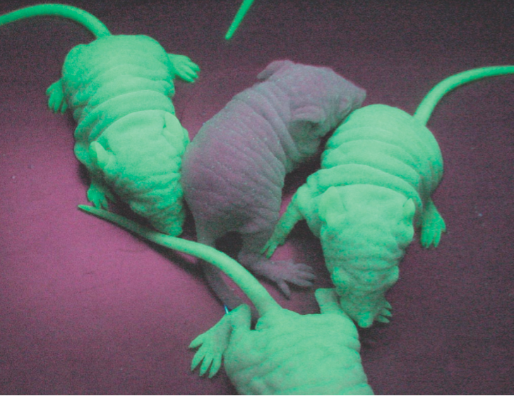
Gene causes these mice to glow in the dark. Normally, the gene is found in jellyfish.

Slide 30
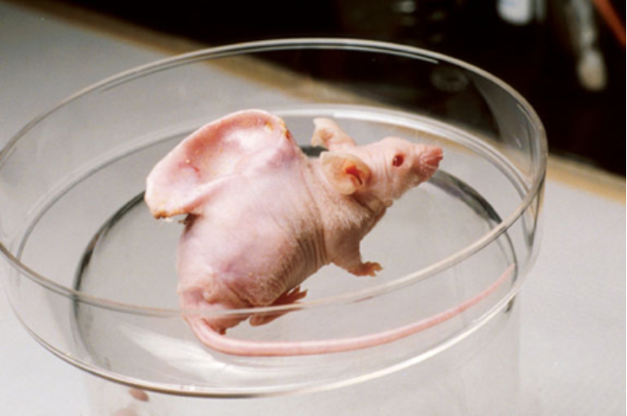

Slide 31
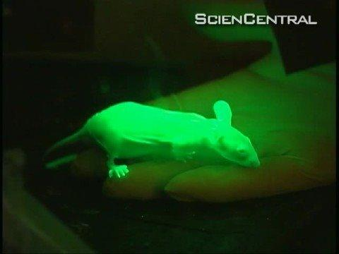

Slide 32
Cloning
member of a population of genetically identical cells produced from a single cell
easy to clone single cell organisms
multicellular organisms more difficult to clone
a twin is a natural clone
1997 Dolly the sheep cloned, 1st mammal

Slide 33
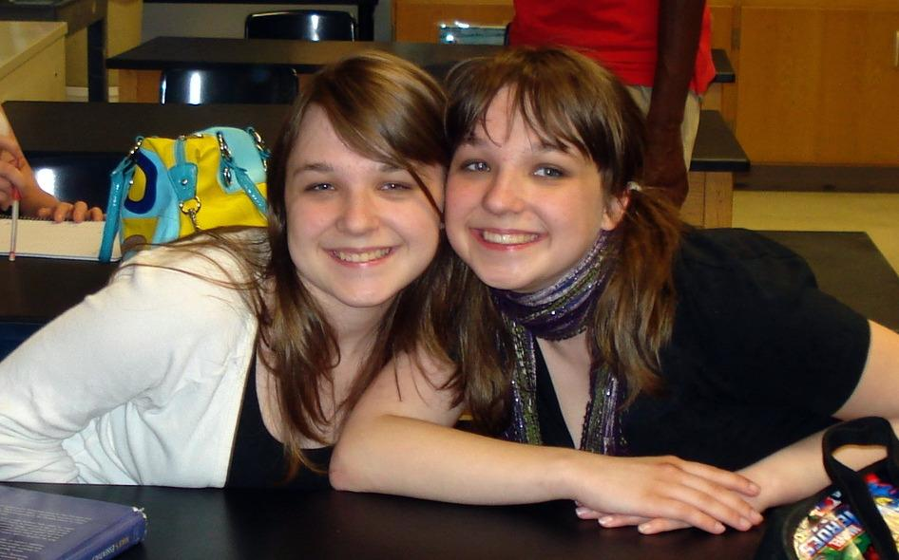
Clones do exist naturally. These are identical twins.

Slide 34
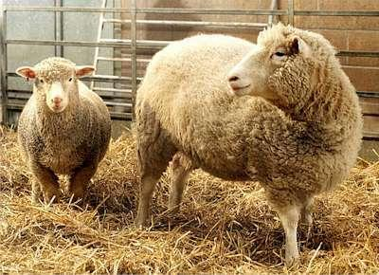

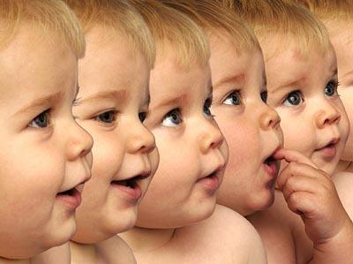

Slide 35
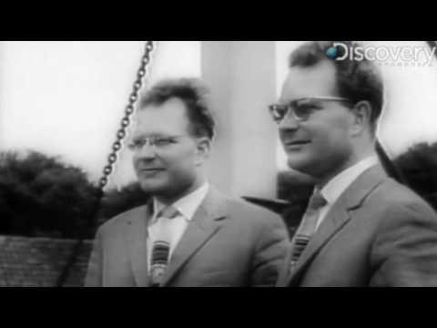

Slide 36
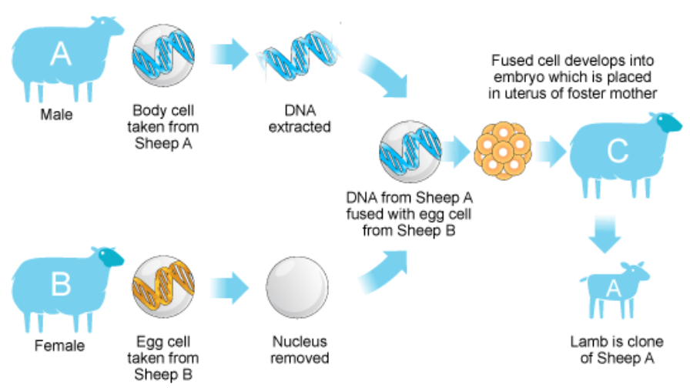
How to Clone a Sheep

Slide 37
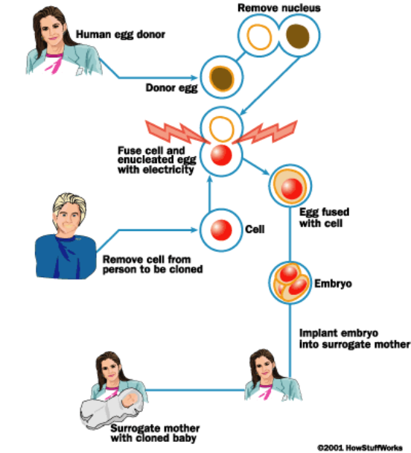
Cloning a Human

Slide 38
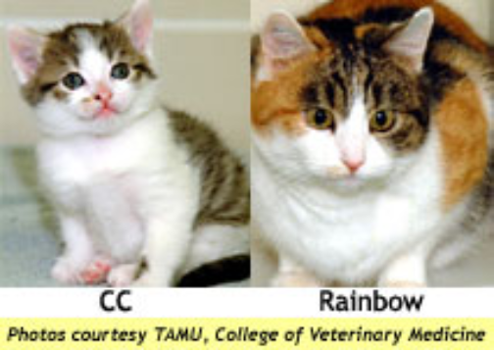
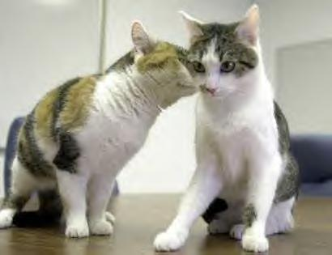
CC was the first cloned cat (Rainbow is the original). CC is short for "Carbon Copy". What is interesting is the color pattern for the clone is different from the original.
The reason is that the genes for color randomly turn on or off for the skin cells, creating random coloration even on the cloned cat.

Slide 39
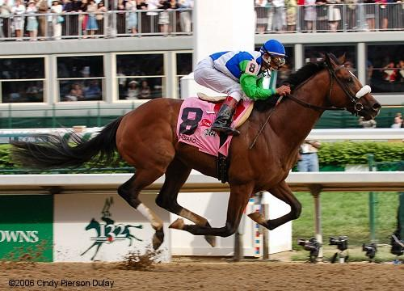
How Can Cloning Be Useful?
1. Save endangered species by storing DNA and cloning
2. Make multiple copies of a useful gene (insulin for diabetics)
3. Clone spare parts, like organs or bone marrow
4. Create experimental groups for studying (animals)
5. Clone "special" animals,
pets or horses

Slide 40

Click and Clone
http://learn.genetics.utah.edu/content/tech/cloning/clickandclone/

Slide 41
1. An animal that contains the genes of another species, like the glow-in-the-dark mice, is called a __________
organism.
2. A _______ is a genetically identical organism.
3. In humans, a naturally occurring clone is a ________
4. The first mammal that was cloned from a skin cell was a _______

Slide 42
5. With regard to cloning...it is necessary to have which of the following? Check all that apply...
___Cell from the adult to be cloned
___Egg with nucleus intact
___Embryo
___Surrogate mother
___ Sperm
___ Stem cells
___ Egg with nucleus removed

Slide 43
BIOETHICS
1. I would use genetic engineering to remove a harmful gene from my unborn child, such as the gene that causes cystic fibrosis.
2. I would use genetic engineering to remove an abnormal (but not necessarily harmful) gene from my unborn child; such as the gene that causes dwarfism.

Slide 44
3. I would use genetic engineering to remove a gene that is not desirable, such as the gene that causes baldness.
4. I would use genetic engineering to change a gene in my unborn child, such as their hair color or eye color.
5. I would use genetic engineering to add a gene to my child that is not human – such as a gene from another organism that could improve sight or running ability.

